Slide 1
Dependence of V_{TH} Stability on Gate-Bias Under Reverse-Bias Stress in E-mode GaN MIS-FET
Reporter:
PB21511897 李霄奕
PB21511894 丁书平

Slide 2
主要内容
Background
Device
Model
Conclusion

Slide 3
Background
01

Slide 4
Background
High power
Electronic vehicle
Sustainable energy
armarium
transportation

Slide 5
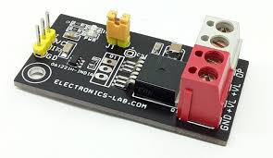
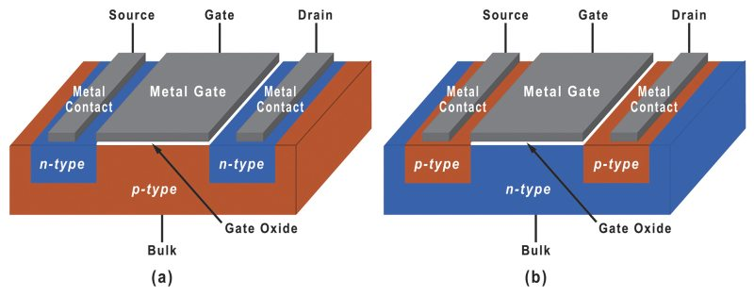
Background
Turn off
Turn on
Strong positive gate bias
Strong negative gate bias
High power switch
Can be Infinite?
No!
V_{TH} Instability

Slide 6
Device
02

Slide 7
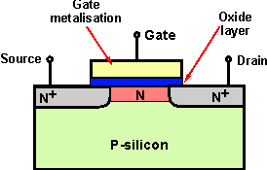
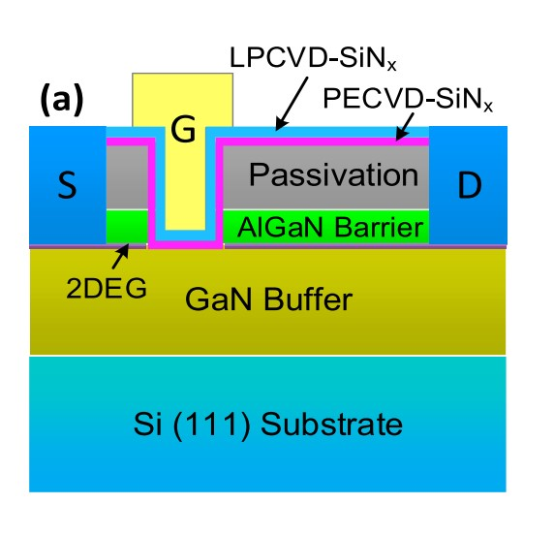
Device
MIS-FET&MOS-FET
O=Oxide
I=insulation
LPCVD&PECVD
High power switch
GaN
fully recessed gate structure
High temp(800°C) deposition
high negative gate bias stress
V_{TH} Instability

Slide 8
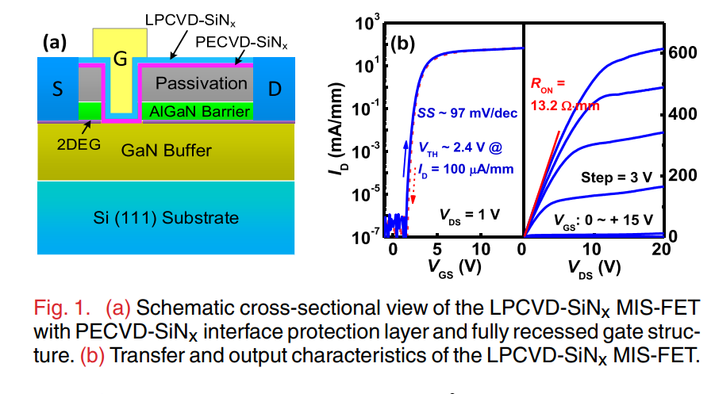
Device
In-class: Parameter Extraction

Slide 9
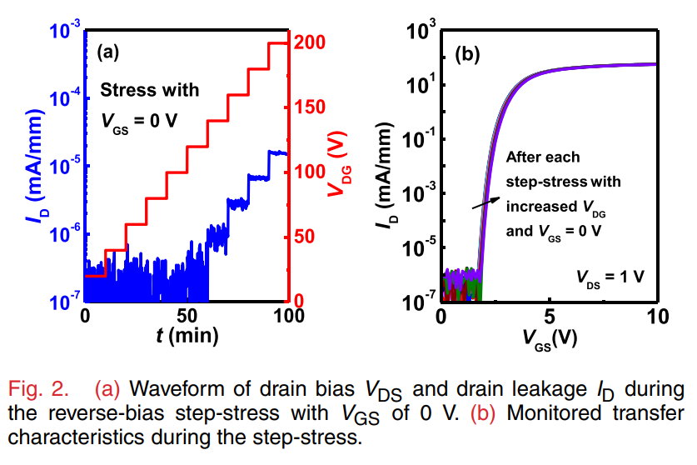
Device
In-class: Transfer Curves
Step-stress V_{DG}=20V:20V:200V
V_{TH} shift<0.14V
Why?

Slide 10
Device
Why V_{TH} shift?
Trap state density in LPCVD-SiNx
Zener trap in AlGaN-GaN
How to prove it?
After 5 min UV(350 nm) illumination , V_{TH} shift eliminated

Slide 11
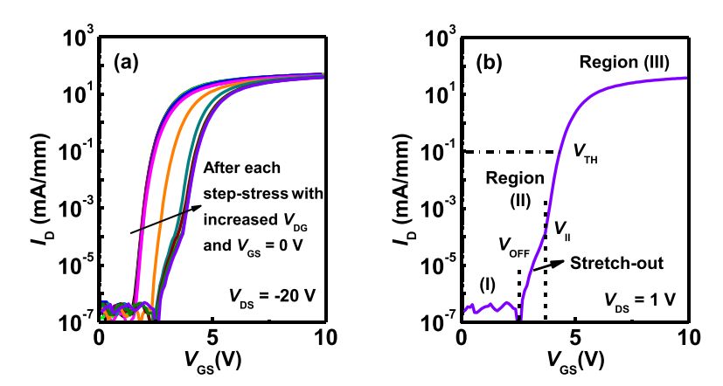
Device
Apply step-stress with V_{GS}=-20V
Aggravated V_{TH} shift

Slide 12
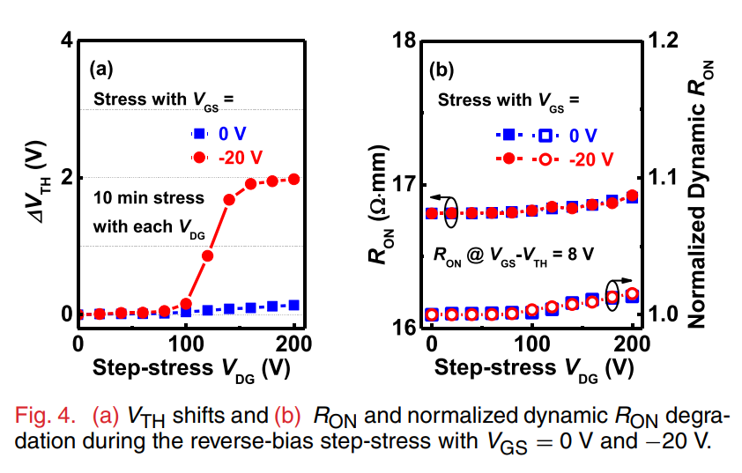
Device
V_{TH} shift can not be recovered with UV
Trap state?
R_{on} is independent of V_{GS}
GaN channel?
Gate dielectric!

Slide 13
Model
03
hole-induced degradation model

Slide 14
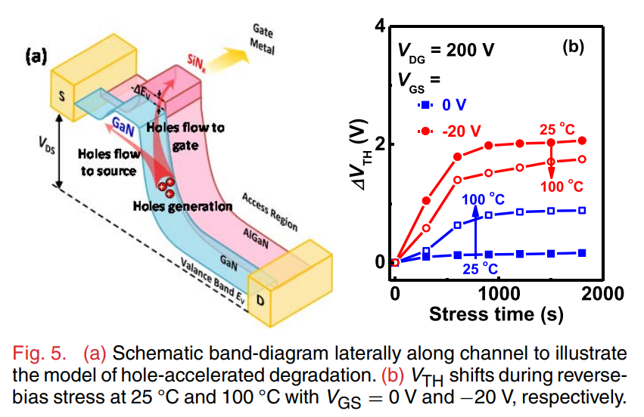
Model
In-class: Zener Trapping
hole-induced degradation model
Strong negative V_{GD}
-> impact ionization
-> enhanced hole flow
-> defect in gate dielectric
-> trap electron
->positive shift of V_{TH}

Slide 15
Model
hole-induced degradation model
Same temperature: V_{GS}=-20V>0V
0V: temp↑,
Source-to-drain leakage ↑,
impact ionization ↑,
ΔV_{TH}↑
-20V: temp ↑,
trap electron ↓,
ΔV_{TH}↓

Slide 16
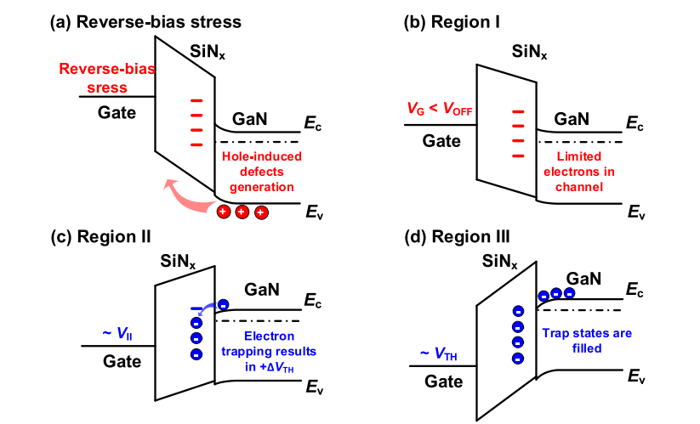
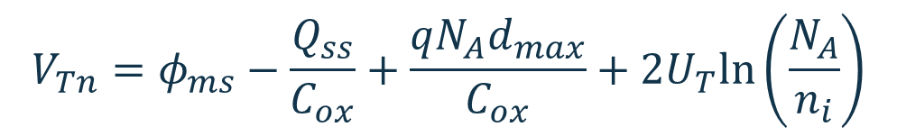
Model
In-class: Trap State
Switch on
Fill trap state
Filled
$$V_{Tn}=φ_{ms}−\frac{Q_{ss}}{C_{ox}}+\frac{qN_{A}d_{max}}{C_{ox}}+2U_{T}ln\left(\frac{N_{A}}{n_{i}}\right)$$

Slide 17
Conclusion
04

Slide 18
Conclusion
VTH instability found in long time strong negative V_{GS}
A hole-induced degradation model
Choose a suitable V_{GS} to obtain stable VTH in high-power switching

Slide 19
Thank you！

